Slide 1

Detection of Pancreatic Cancer
Under The Supervision of Mr. Naga Babu Pachhala M.Tech(Ph.D) Assistant Professor
Presented By
- 20BQ1A1299
- 20BQ1A12C4
M.Devi Siva Sai
P. Prudhvi
G.Naga Venkata Sai Gopi - 20BQ1A1264
I.Ganeswara Naga Sai Ram - 20BQ1A1266
M.Ram Sandeep - 20BQ1A12A2
Department of Information Technology Vasireddy Venkatadri Institute of Technology Pedakakani Mandal, Namburu, Guntur-522508
1

Slide 2
Contents
Abstract
Introduction
Existing System
Proposed System
Hardware And Software Requirements
Functional Requirements
Non-Functional Requirements
System Architecture
System Design
Output Screens
System Testing
Conclusion
Future Scope
Reference

Slide 3
ABSTRACT
Pancreatic cancer has a terrible prognosis by having a survival rate of five years only. The premise behind early detection and better survival is that more people will benefit from a possible treatment. Pancreatic cancer is a devastating disease with a high mortality rate, often diagnosed at advanced stages when treatment options are limited. Early detection plays a crucial role in improving patient outcomes. The great majority of the computer systems that are now being utilized for research on medical health systems are based on the most recent technical breakthroughs. Because of the prevalence of pancreatic cancer, a significant number of novel approaches and techniques have emerged in the field of medicine. There are several various classifications that may be applied to the pancreatic cancer that can be found. The classification of pancreatic cancer may be tackled from a variety of angles, each of which can be accomplished via using either technology for machine learning or technology for deep learning. In the past, a diagnosis of pancreatic cancer could be made by using methods such as the RF, Support Vector Machine (SVM),Extra Tree , Decision Tree. However, these strategies do not deliver an accurate performance. As a result, this study has implemented a Random Forest Classifier due to its ability to handle complex relationships within the data.

Slide 4
INTRODUCTION
Pancreas a crucial endocrine organ found under the stomach and when the cancer
cells starts developing, it turns into the pancreatic cancer.
This type of cancer is very difficult to detect as it is never seen in the early phases.
The most common signs that a person can reflect of having pancreatic cancer is
jaundice and abrupt loss in their weights.
It is the world's second most frequent cancer. It aids digestion by creating enzymes that the body requires to break down lipids, carbs, and proteins.
This project addresses the critical need for early detection of pancreatic cancer, a
disease notorious for its late-stage diagnosis and limited treatment options.
Early detection is crucial for improving the chances of successful treatment. Machine learning techniques, such as Random Forest, capable of identifying potential cases of pancreatic cancer in its early stages.

Slide 5
EXISTING SYSTEM
In the Existing System the classification algorithms of machine learning with the best accuracy are needed to assist the medical field in classifying individuals with pancreatic cancer. In this research, classification algorithms of Decision Tree and Logistic Regression were used. Furthermore, these two methods were compared to discover which has the best performance based on accuracy. The results showed that the Decision Tree and Logistic Regression yielded 50% and 72.68% respectively as their highest accuracy. Therefore, the Logistic Regression is a better method based on accuracy for classifying pancreatic cancer.

Slide 6
PURPOSE
The proposed system analyzes the accuracy of prediction of PC using machine learning techniques: SVM, Random Forest , Decision Tree and Extra Tree Classifier. These classifiers come under the category of supervised learning in machine learning. The classifier or the algorithm will be trained with the dataset that has the features and labels regarding PC, hence it becomes a trained model to predict the label. The trained model will be tested with new data or with random features from dataset The performance of SVM, Random Forest , Decision Tree and Extra Tree Classifiers are compared to find out which classifier have better accuracy among them. Also predicts the outcome that is whether the chosen person has the disease or not. By comparing the values that are given from those methods , it is possible to conclude that Random Forest generates a better result than SVM, Extra Tress and Decision Tree.

Slide 7
HARDWARE AND SOFTWARE REQUIREMENTS
HARDWARE REQUIREMENTS:
HARD DISK : 500 GB - 1 TB
RAM : 4GB
PROCESSOR : Intel core i5
SOFTWARE REQUIREMENTS:
OPERATING SYSTEM : WINDOWS 7 AND ABOVE
TECHNOLOGY STACK : PYTHON 3.6
TOOLS : JUPYTER NOTEBOOK 6.0.3, FLASK,PYCHARM

Slide 8
FUNCTIONAL REQUIREMENTS
1. Data Loading : The data that we need to load for starting any of the ML project. With respect to data, the most common format of data for ML projects is CSV (comma-separated values).
2. Data Preprocessing : Data preprocessing is about preparing the raw data and making it suitable for a machine learning model.
3. Model Training :Model training is a fundamental step in machine learning where a model learns the patterns and relationships within the data.
4.Model Evaluation : Admin should be able to evaluate the accuracy and performance of the trained model.
5. Prediction : Once a machine learning model has been trained on a dataset, it can be applied to make predictions on new instances based on the learned patterns and relationships.

Slide 9
NON FUNCTIONAL REQUIREMENTS
1. Performance Requirements:
The necessitate the ability to process and analyze a high volume of Data in real-time with low latency responses to ensure timely and effective fraud detection.
2. Safety Requirements :
The system should not present any safety hazards to users.
3. Security Requirements :
The security requirements are encompass robust encryption, access controls, secure data storage, and stringent authentication measures to safeguard sensitive data and protect against cyberattacks.

Slide 10
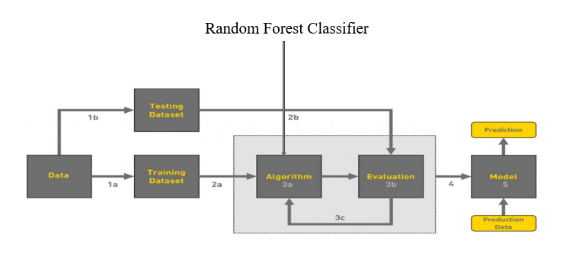
Architecture
Healthy
Pancreatic

Slide 11
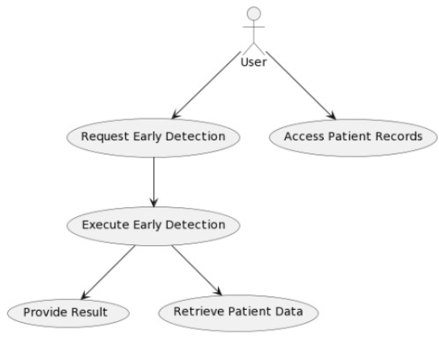
System Design
Use case Diagram:

Slide 12
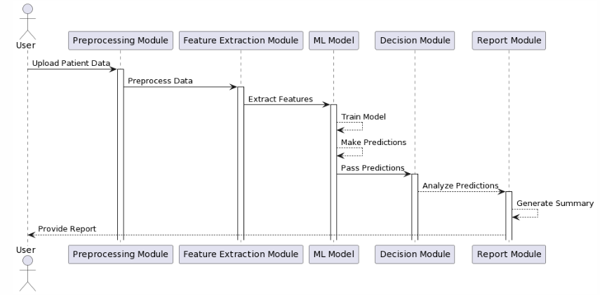
SEQUENCE DIAGRAM

Slide 13
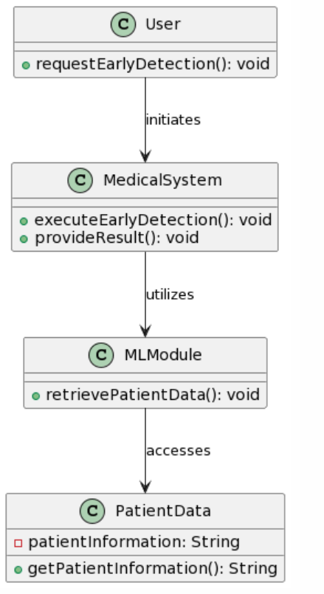
CLASS DIAGRAM

Slide 14
Implementation Code
import numpy as np
import pandas as pd
from sklearn import metrics
import matplotlib.pyplot as plt
df=pd.read_csv("pradataset.csv")
df.isnull().sum()
df=df.drop("sample_id",axis=1)
df["patient_cohort"].unique()
df["diagnosis"].unique()
from sklearn import preprocessing
label_encoder = preprocessing.LabelEncoder()
df['patient_cohort']= label_encoder.fit_transform(df['patient_cohort'])
df['patient_cohort']=df['patient_cohort'].astype(int)
df['patient_cohort']=df['patient_cohort'].astype(int)
df['sample_origin']= label_encoder.fit_transform(df['sample_origin'])
df['sample_origin']=df['sample_origin'].astype(int)
df['sex']= label_encoder.fit_transform(df['sex'])

Slide 15
df['sex']=df['sex'].astype(int)
df['diagnosis'].unique()
df['stage']=df['stage'].fillna('0')
df['stage'].unique()
df['stage']= label_encoder.fit_transform(df['stage’])
df['stage']=df['stage'].astype(int)
df['benign_sample_diagnosis'].unique()
df['benign_sample_diagnosis']=df['benign_sample_diagnosis'].fillna("null")
df['plasma_CA19_9']=df['plasma_CA19_9'].fillna(df['plasma_CA19_9'].mean())
df['REG1A']=df['REG1A'].fillna(df['REG1A'].mean())
df=df.drop("benign_sample_diagnosis",axis=1)
X=df.drop("diagnosis",axis=1)
y=df['diagnosis']
# Build a Dataframe with Correlation between Features
corr_matrix = X.corr()
# Take absolute values of correlated coefficients
corr_matrix = corr_matrix.abs().unstack()
corr_matrix = corr_matrix.sort_values(ascending=False)

Slide 16
corr_matrix = corr_matrix[corr_matrix >= 0.8]
corr_matrix = corr_matrix[corr_matrix < 1]
corr_matrix = pd.DataFrame(corr_matrix).reset_index()
corr_matrix.columns = ['feature1', 'feature2', 'Correlation']
corr_matrix.head()
# Import label encoder
from sklearn import preprocessing
# label_encoder object knows how to understand word labels.
label_encoder = preprocessing.LabelEncoder()
y= label_encoder.fit_transform(y)
from sklearn.model_selection import train_test_split
X_train, X_test, y_train, y_test = train_test_split(X, y, test_size=0.33, random_state=60)
from sklearn.ensemble import ExtraTreesClassifier
Etc=ExtraTreesClassifier(n_estimators=100,max_depth=6,min_samples_split=2,min_weight_fraction_leaf =0.0,n_jobs=-1)

Slide 17
etc.fit(X_train, y_train)
print(etc.score(X_test, y_test)*100)
y_pred9 = etc.predict(X_test)
from sklearn.metrics import precision_recall_fscore_support
precision_recall_fscore_support(y_test, y_pred9, average='macro')
from sklearn.ensemble import RandomForestClassifier
clf = RandomForestClassifier(n_estimators = 100)
clf.fit(X_train, y_train)
y_pred8 = clf.predict(X_test)
from sklearn import metrics
print()
# using metrics module for accuracy calculation
print( metrics.accuracy_score(y_test, y_pred8)*100)
from sklearn.metrics import precision_recall_fscore_support

Slide 18
precision_recall_fscore_support(y_test, y_pred8, average='macro')
from sklearn.tree import DecisionTreeClassifier
dtc=DecisionTreeClassifier()
dtc.fit(X_train, y_train)
y_test_predict2=dtc.predict(X_test)
test_accuracy=(metrics.accuracy_score(y_test,y_test_predict2)*100)
test_accuracy
from sklearn.svm import SVC
from sklearn.metrics import accuracy_score
svc= SVC()
svc.fit(X_train,y_train)
y_test_predict4=svc.predict(X_test)
test_accuracy=(accuracy_score(y_test,y_test_predict4)*100)
test_accuracy
df.head()

Slide 19
APP.PY
from flask import Flask, render_template, request import numpy as np import pickle model = pickle.load(open(r"pancreas.pkl", 'rb')) app = Flask(__name__) @app.route("/") def about(): return render_template('home.html') @app.route("/home") def about1(): return render_template('home.html') @app.route("/predict") def home1(): return render_template('predict.html') @app.route("/performance_analysis") def performance_analysis(): return render_template('Performance_analysis.html') @app.route("/Abouting")

Slide 20
def aboutuss(): return render_template('aboutuss.html') @app.route("/pred", methods=['POST', 'GET']) def predict(): x = [[x for x in request.form.values()]] print(x) x = np.array(x) print(x.shape) print(x) pred = model.predict(x) if pred == 0: pred = 'Healthy' elif pred == 1: pred = 'Benign hepatobiliary Disease' else: pred = 'Pancreas Cancer Detected' return render_template('submit.html', prediction_text=str(pred)) if __name__ == "__main__": app.run(debug=True)

Slide 21


OUTPUT SCREENS

Slide 22
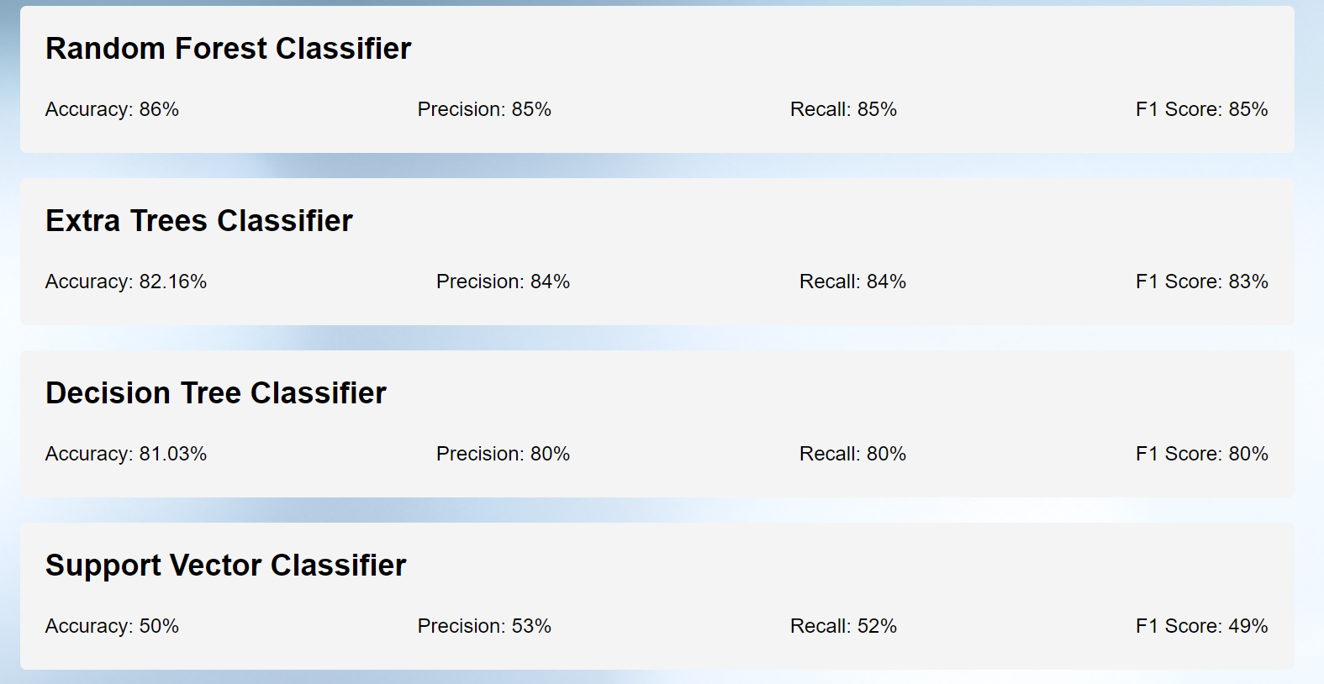
Performance Analysis:

Slide 23
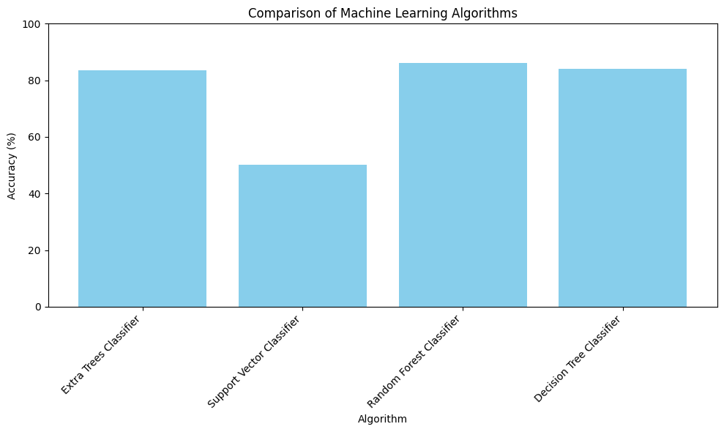

Slide 24
CONCLUSION
Early detection of Pancreatic Cancer is very important so that the handling of Pancreatic Cancer does not occur too late, before the cancer spreads to other organs in the body. However, early detection of PC is difficult because this cancer has non-specific symptoms.
After classifying Pancreatic Cancer with SVM, Extra Tress, Decision Tree and Random Forest methods, it gets several results of accuracy. By comparing the values that are given from those methods , it is possible to conclude that Random Forest generates a better result than SVM, Extra Tress and Decision Tree. Because of the good results, Random Forest is suggested to help the medical staff to predict or classify a disease rather than SVM, Extra Tress and Decision Tree, especially for a dataset that is similar to this research.
The average rate of accuracy of Extra Trees Classifier is 82.1%, SVM is 50%, Decision Tree Classifier is 81.3% and for Random Forest Classifier is 86.34%. From this, it is clear that Random Forest gives an accurate result than the other three classifier algorithm. So, it can be concluded that Random Forest Classifier performs better than the other three classification algorithms.

Slide 25
Future Scope
The future scope of the project could involve the following advancements:
Keep making our computer tool smarter by trying out even better tricks and techniques beyond what we're using now.
Imagine connecting our tool with cool gadgets people wear, like smartwatches or health monitors. This way, it can gather more information and become even better at spotting signs of pancreatic cancer.
Think about how our tool could keep an eye on people's health all the time, not just once in a while. This might help predict problems early, like a superhero warning us about potential health issues.

Slide 26
REFERENCE
[1] E. Grywalska et al., "Current Possibilities of Gynecologic Cancer Treatment with the Use of Immune Checkpoint Inhibitors," International Journal of Molecular Sciences, vol. 20, no. 19, September 2019.
[2] S. Midha, S. Chawla, and P. K. Garg, "Modifiable and non-modifiable risk factors for pancreatic cancer: A review," Cancer Letters, vol. 381, no. 1, pp. 269–277, October 2016.
[3] McGuigan, A. et al., "Pancreatic cancer: A review of clinical diagnosis, epidemiology, treatment, and outcomes," World Journal of Gastroenterology, vol. 24, no. 43, pp. 4846-4861, November 2018.
[4] Y. Qiu et al., "Towards Prediction of Pancreatic Cancer Using SVM Study Model," Journal of Clinical Oncology and Research, vol.2, no.4, May 2014.
[5] F. Bray et al. "Global Cancer Statistics 2018: GLOBOCAN estimates of incidence and mortality worldwide for 36 cancers in 185 countries," CA: A Cancer Journal for Clinicians, vol. 68, no. 6, pp. 394-424, September 2018.
[6] H. Matsubayashi et al. "Familial pancreatic cancer: Concept, Management, and Issues," World Journal of Gastroenterology, vol. 23, no. 6, pp. 935-948, February 2017.
[7] Rawla, Sunkara, & Gaduputi, "Epidemiology of Pancreatic Cancer: Global Trends, Etiology, and Risk Factors," World Journal of Oncology, vol. 10, no. 1, pp. 10-27, February 2019.

Slide 27
[8] M. S. De La Cruz, A. P. Young, and M. T. Ruffin. "Diagnosis and management of pancreatic cancer," American Family Physician, vol. 89, no. 8, pp. 626-632, April 2014.
[9] Kuroczycki-Saniutycz et al., "Prevention of pancreatic cancer," Contemporary Oncology (Pozn), vol. 21, no. 1, pp. 30–34, February 2017.
[10] Vareedayah, S. Alkaade, and J. R. Taylor, "Pancreatic Adenocarcinoma," Missouri Medicine, vol. 115, no. 3, pp. 230–235, May/June 2018.
[11] Capasso, M., et al., "Epidemiology and risk factors of pancreatic cancer," Acta Bio Medica Atenei Parmensis, vol. 89, no. 9-S pp. 141-146, December 2018.
[12] T. Nadira and Z. Rustam. "Classification of cancer data using support vector machines with features selection method based on global artificial bee colony," AIP Conference Proceedings, vol. 2023, October 2018.
[13] Aroef, Rivan, & Rustam, "Comparing random forest and support vector machines for breast cancer classification," TELKOMNIKA (Telecommunication Computing Electronics and Control), vol. 18, no. 2, pp. 815-821, April 2020.
[14] U. Aprilliani and Z. Rustam, "Osteoarthritis disease prediction based on random forest," in 2018 International Conference on Advanced Computer Science and Information Systems (ICACSIS), Yogyakarta, pp. 237–240.
[15] M. Huljanah, Z. Rustam, S. Utama, and T. Siswantining. "Feature Selection using Random Forest Classifier for Predicting Prostate Cancer," IOP Conf. Ser.: Mater. Sci. Eng, vol. 546, no. 5, July 2019.

Slide 28


